Slide 1
Information for The Crucible Literary Analysis
Notes for Wednesday, October 16th

Slide 2
Goals for Today
Finish topic sentences for body paragraphs
* do not worry about the introductory paragraph
Find evidence in the text to support your topic sentences.
Every paragraph should have at least one piece of evidence from the text.
Start typing body paragraphs
** UPDATE: Rough Draft due on Friday at the beginning of Class**

Slide 3
How to Cite a Play
Usually when you cite a play you do so by Act, Scene, Line, etc.
HOWEVER,
Arthur Miller does not provide us with all of this information.
So, we are going to use MLA in-text citations. (Author’s Last Name Page #)
Ex. (Miller 24).
REMEMBER: The period goes at the end of the parenthesis.

Slide 4
MLA Formatted Paper

Slide 5
Remember our FOCUS AREA: Semicolons and Colons

Slide 8
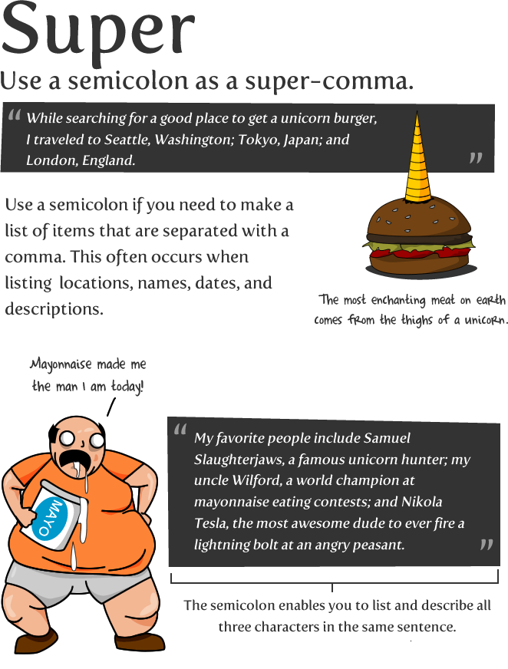

Slide 11
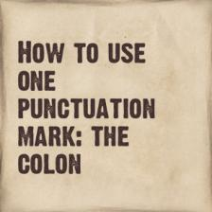

Slide 12
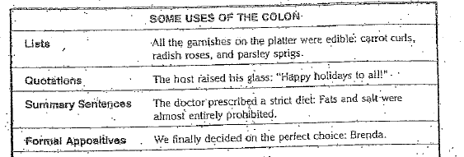

Slide 13
Colons
The most important thing to remember about colons is that you only use them after statements that are complete sentences.
An easy way to incorporate a colon into this essay is to use one while you’re blending your citations.

